Slide 1

MS 101 Makerspace
Lecture 3: Assembly in Solid Modeling
Soham Mujumdar
S23, Mechanical Engineering
Email: sohammujumdar@iitb.ac.in
Reference: D.K. Lieu, S. Sorby, "Visualization, Modeling and Graphics for Engineering Design", Cengage Learning, 2nd Edition, 2016.

Slide 2
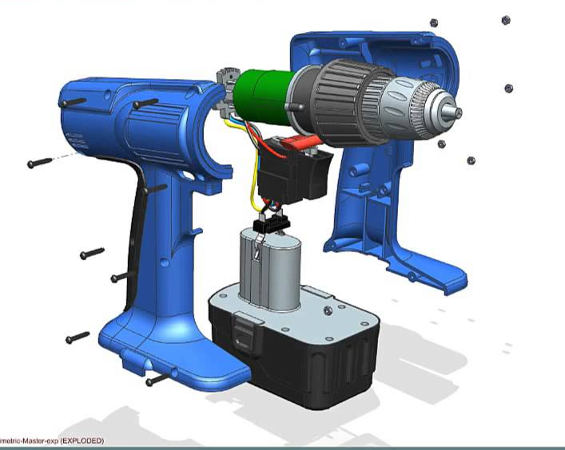
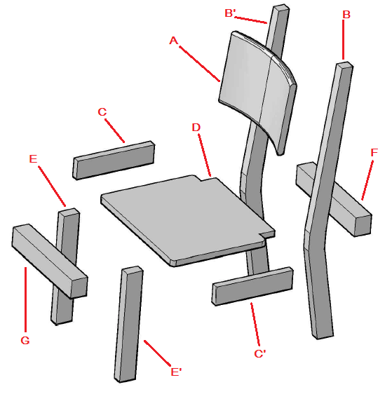
Assembly Examples
Most of the products we use are assembled from two or more components
https://www.youtube.com/watch?v=MJyee49qAGY
https://shalindesigns.com/furniture-design/

Slide 3
Lecture Objectives
Apply new terminology in the context of assembly modeling
Create an appropriate hierarchy for effective assembly modeling
Apply assembly constraints between instances
Create a bill of materials and an assembly drawing
Determine interferences and clearances between instances in an assembly
Be familiar with analysis (stress and motion)

Slide 4
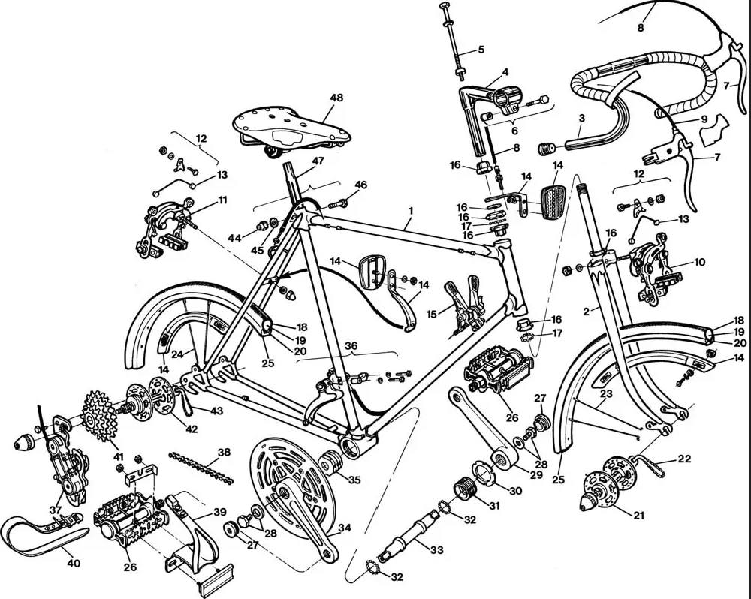
Assembly Terminology
Most of the engineering products are made up of multiple parts known as ‘components’ (of the assembly)
Many times, there are multiple copies of a part used in an assembly. These copies are called ‘instances’ (of the component).
‘Subassembly’ is a subgroup of components within the overall assembly.
‘Associativity’ means attributes (e.g. geometry, material properties etc.) attached to a part. Any change in the associativity will impact the part and its instances.
‘Assembly hierarchy’ is the organization or structure of a system.

Slide 5
Assembly Terminology
Usually the stationary component in assembly is selected to serve as the “BASE INSTANCE”. A point is identified as origin and reference planes (e.g. x-y, y-z, z-x) are identified.
All other instances/parts are described w.r.t. the X-Y-Z co-ordinate system.
Every instance has 6 degree of freedoms (DOFs) (3 translation and 3 rotation).
Any constraint applied to the assembly reduces the DOFs.

Slide 6
Assembly Examples
Type of joint/connection between two components can be of many types
https://www.youtube.com/watch?v=MJyee49qAGY
https://shalindesigns.com/furniture-design/

Slide 7
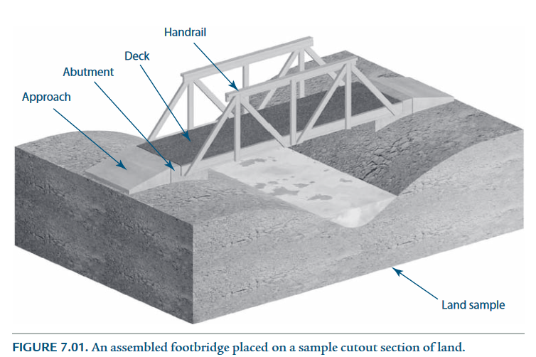
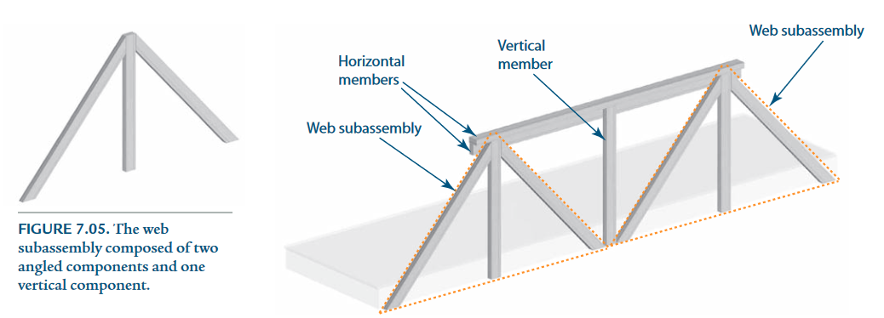
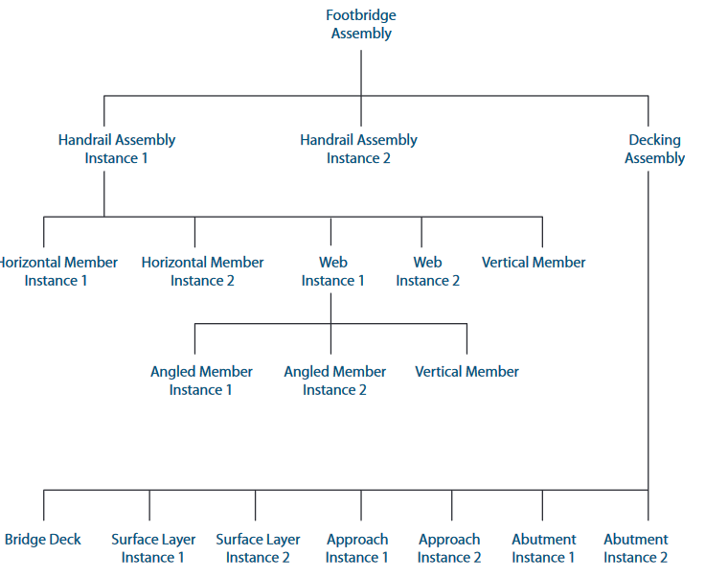
Assembly Example

Slide 8
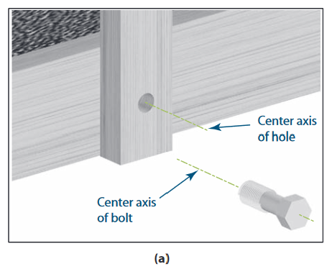
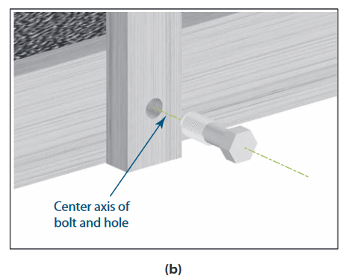
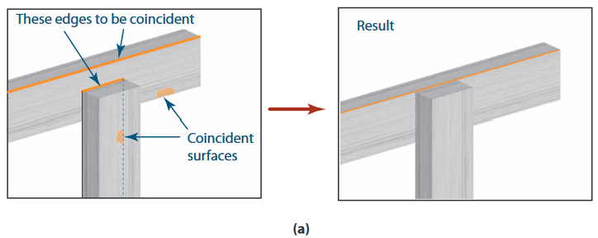
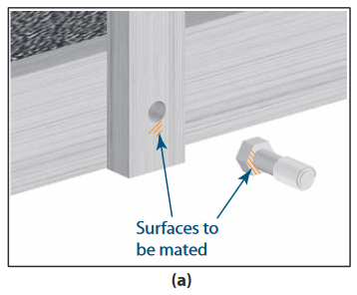
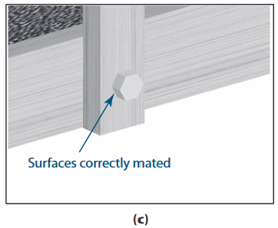
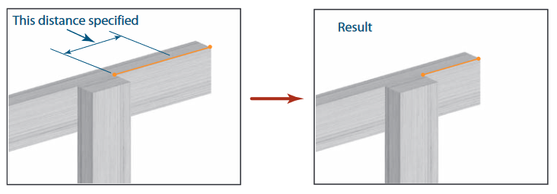
Assembly Constraints
Concentric Constraint
Coincident Constraint (lines/points)
Mating Surface Constraint (with or w/o gaps)
Distance Constraint

Slide 9
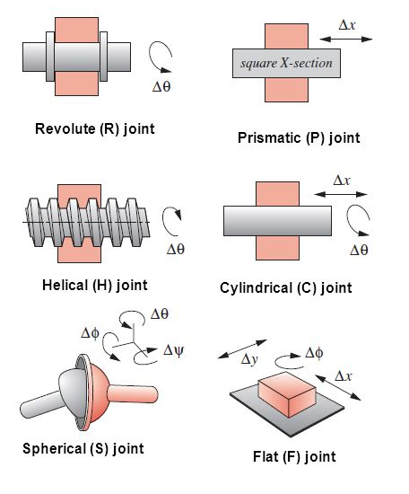
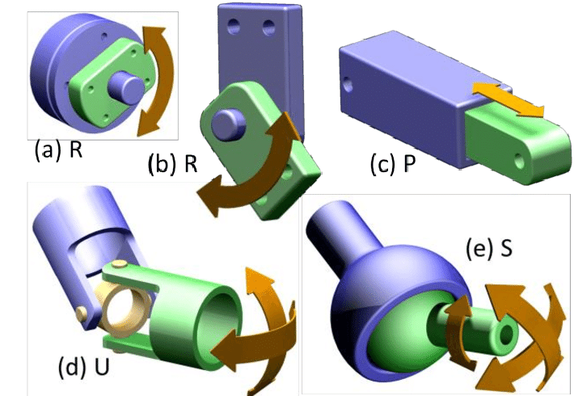
Joints
Revolute Joint
Rotational Joint
Slider/Prismatic Joint
Ball Joint

Slide 10
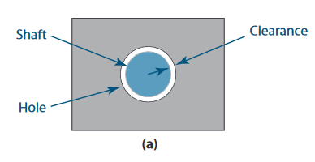
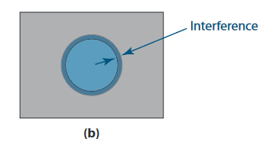
Interference vs Clearance
Interference is the amount of overlap between instances/parts
Clearance is the minimum distance between instances/parts

Slide 11
Exploded Configuration
Representation of the components in the assembly
The view also provides relationship between different components
Easy to understand and visualize

Slide 12
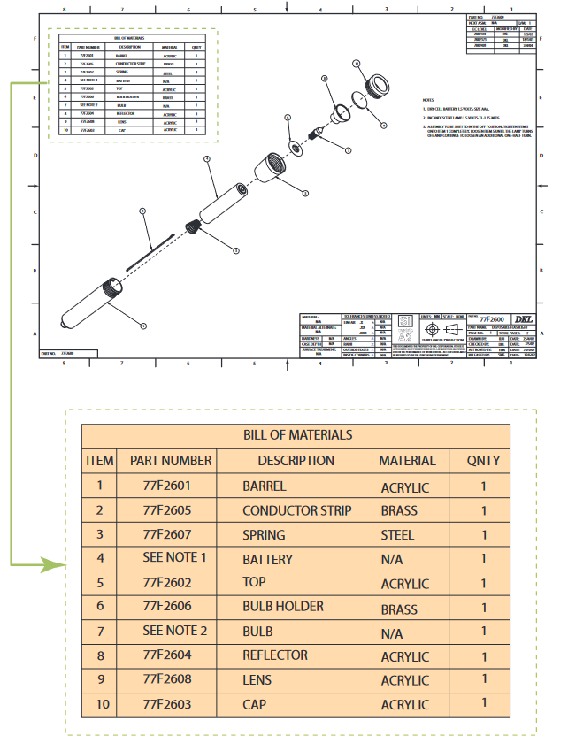
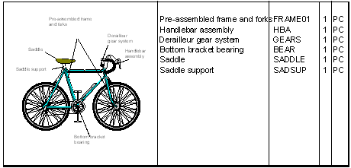
Bill of Materials
A bill of materials (BOM) is a comprehensive inventory of the raw materials, assemblies, subassemblies, parts and components, as well as the quantities of each needed to manufacture a product.

Slide 13
Assembly Strategy: Bottom-up vs Top-down
Bottom-up
All the parts are firstly created
Assembly hierarchy is established
Orient the instances using constraints to establish relationship between parts
Check for interference/clearances
Obtain the bill of materials
Exploded view for assembly
Drawing
Top-down
System is first defined
Space is identified for sub-assemblies, parts
Function of each component is articulated and known apriori
Usually the preferred approach in professional scenario

Slide 14
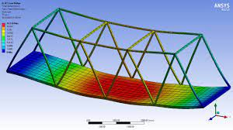
Analysis
Geometric Property Analysis: Surface area, Volume, Distance between two entities, Angle between two entities
Mass Property Analysis: Mass, Density, Centroid, Moment of Inertia
Finite Element Analysis (FEA):
Useful to assess the correctness of design from the point-of-view of FAILURE
Under working conditions, the components/parts are subjected to temperature, wind pressure, gravity, contact induced forces etc.
Internal forces are generated in the body described as “STRESS”
To avoid failure, stress should not exceed material prescribed “STRENGTH”
FEA helps in the calculation of STRESS under complex loading in a realistic geometry
Output of FEA is used to infer chances of failure, life, design effectiveness

Slide 15
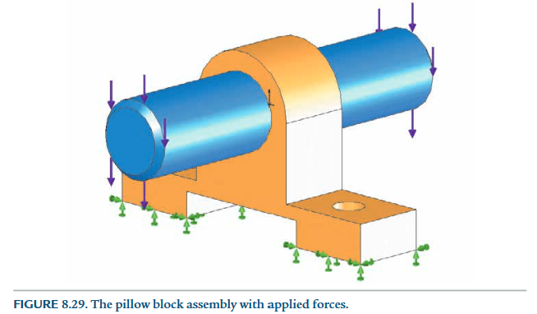
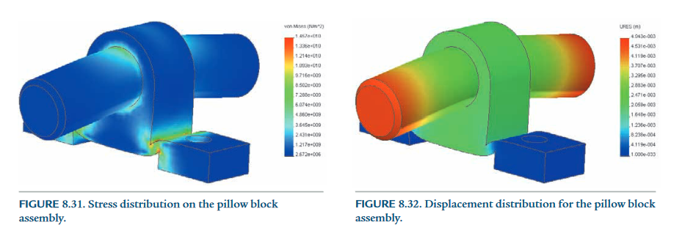
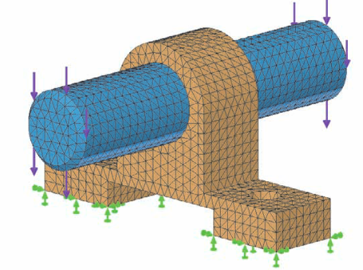
FEA
Finite Element Mesh: The part to be analyzed is divided into small finite-sized sub-volumes known as elements.
Boundary conditions in the form of either forces or displacement is specified along the surface of the component to be analyzed using finite element method
FEA can also be used to find out temperature distribution, electromagnetic field by choosing appropriate module.

Slide 16
Motion Analysis
Study of evolution of position, velocity, acceleration and torque with time when the model is assumed to be composed of assemblage of rigid bodies and subjected to time varying external loads
Kinematics: Describes motion of objects without consideration of forces
Dynamics: Study of masses and inertial forces acting on mechanism
Rigid body dynamics: Objects are 3D with center of mass, moment of inertia
Application:
Time required to complete an operation,
Force required to lift an object,
Size of motor required
Correctness of motion etc.

